Slide 1


STUDENT NAME : KANISHWAR.Y
REGISTER NO AND NMID : 212400945/FAC921EEB3F72BEA6B7475A335C66047
DEPARTMENT : BCA
COLLEGE : PRINCE SHRI VENKATESWARA ARTS AND SCIENCE COLLEGE

Slide 2
PROJECT TITLE
▶ DIGITAL PROTFOLIO

Slide 3
AGENDA
PROBLEM STATEMENT
PROJECT OVERVIEW
END USERS
TOOLS AND TECHNOLOGIES
PORTFOLIO DESIGN AND LAYOUT
FEATURES AND FUNCTIONALITY
RESULTS AND SCREEN SHOTS
CONCLUSION
GITHUB LINK

Slide 4
Problem Statement
▶ Lack of a structured way to showcase academic and personal projects.
▶
▶ Difficulty in presenting skills and achievements effectively.
▶
▶ Need for a digital platform to display work.

Slide 5
Project Overview
▶ A personal portfolio website.
▶
▶ Developed using HTML, CSS, JavaScript.
▶
▶ Showcases About Me, Skills, Projects, and Contact Information.

Slide 6
End Users
▶ Students who want to display their skills/projects.
▶
▶ Recruiters and employers.
▶
▶ Teachers and mentors for evaluation.

Slide 7
Tools and Technologies
▶ HTML for structure.
▶
▶ CSS for styling.
▶
▶ JavaScript for interactivity.

Slide 8
Portfolio Design and Layout
▶ Clean and simple design.
▶
▶ Sections: About Me, Skills, Projects, Contact.
▶
▶ Responsive and user-friendly interface.

Slide 9
Features and Functionality
▶ Showcases personal details.
▶
▶ Highlights technical skills.
▶
▶ Lists completed projects.
▶
▶ Provides contact information.

Slide 10
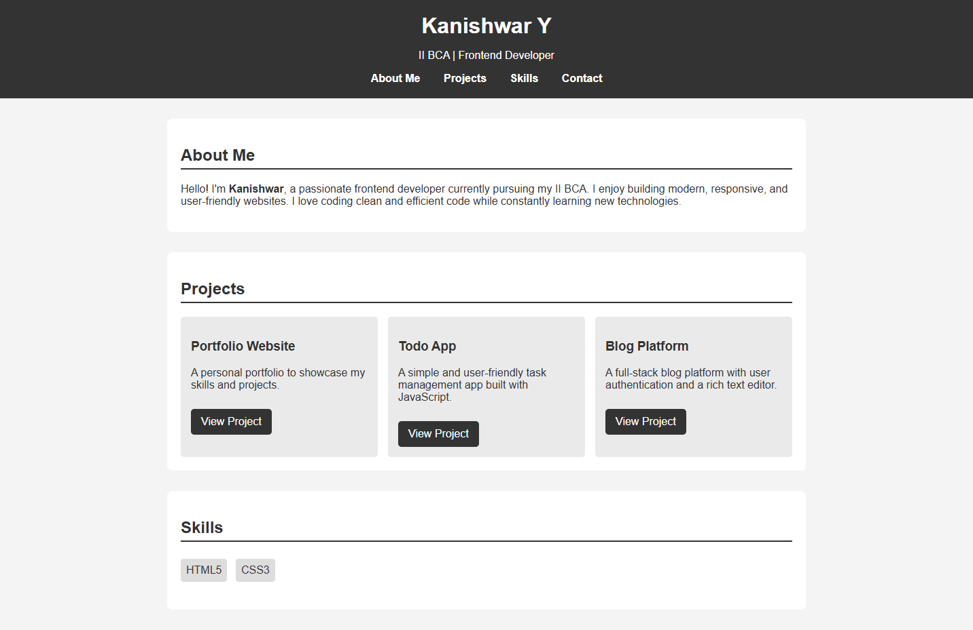
Results and Screenshots

Slide 11
Conclusion
▶ Created a functional portfolio using web technologies.
▶
▶ Helpful for career opportunities.
▶
▶ Provides an online presence.

Slide 12
Github Link
https://13355bca2024-coder.github.io/TNSDC-FWD-DP-KANISHWAR-PORTFOLIO/

